Slide 1

MAINTAINING STREAM STATISTICS OVER SLIDING WINDOWS
Omar cusma fait

Slide 2

The Data Stream
Data streams: A continuous flow of data elements that arrive sequentially
Challenges:
Large volumes of data
Only care about the last n data-points
Efficiency
Need for real-time analysis

Slide 3
The Sliding Window
Sliding window: A subset of the most recent data elements
Goal: Maintain accurate statistics over the sliding window
Applications: Network monitoring, financial analysis, fraud detection, …
1 1 0 1 1 1 0 0 1 1 1 0 1 1 1 1 0 1 0 0 …

Slide 4




Naïve Methods
Some naïve methods include
Saving all the last bits of the stream (O(n) space)
Passing down a bit of the count from each bucket to the next one, and spilling out from the last one

Slide 5




The Exponential Histogram (EH) Algorithm
A novel algorithm for maintaining approximate counts of 1's in a sliding window
Bucket structure: Divides the sliding window into buckets of exponentially increasing sizes. Each bucket stores the sum of the values, and the timestamp of its most recent 1 and the number of 1's it contains
Bucket merging: Merges buckets to maintain a balanced distribution of 1's. Count estimation: Estimates the total count of 1's based on the bucket sizes

Slide 6
The Exponential Histogram (EH) Algorithm
A novel algorithm for maintaining approximate counts of 1's in a sliding window
Filling: The newest bucket is filled
Spilling: The last bucket is gradually emptied, and then removed

Slide 7
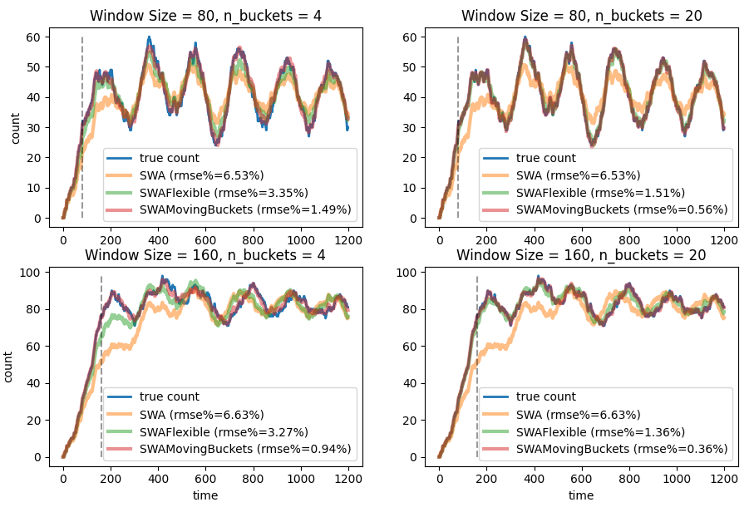
Performance

Slide 8

Advantages of the EH algorithm
Efficient memory usage
Accurate estimates for non-uniform data distributions
High degree of control over the entire list of buckets to adapt to non-uniform bit streams

Slide 9
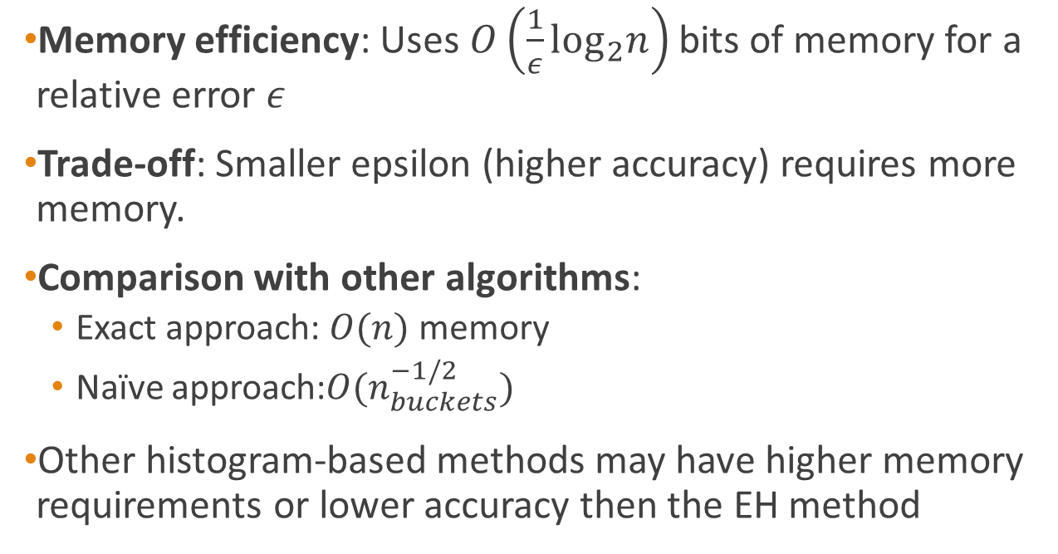
Space and Time Complexity
Memory efficiency: Uses $O\left(\frac{1}{ε}\log_{2}n\right)$ bits of memory for a relative error $ε$
Trade-off: Smaller epsilon (higher accuracy) requires more memory.
Comparison with other algorithms:
Exact approach: $O(n)$ memory
Naïve approach:${O(n}_{buckets}^{−1/2})$
Other histogram-based methods may have higher memory requirements or lower accuracy then the EH method

Slide 10

Extensions and Applications
Outlook: How the EH algorithm can be extended to handle data elements with positive integer values
Applications of the EH algorithm in various domains (e.g., network monitoring, financial analysis)

Slide 11
THANK YOU!

